Slide 1
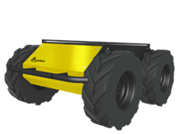
Brain Simulation
Brain Adapter
Transfer Functions
Robot Adapter
World Simulation
Generator Device
Spike Generator
Camera Subscriber
Camera-Sensor
Camera2Spikes
Neuron2Motor
Voltage Detector
Run
Left Motor Publisher
Left Motor
Artificial neuron
RunStep(dt)
Start
RunStep(dt)
Stop
Data Flow
Controls
Brain Controller
Closed Loop Controller
Robot Controller
Requests

